Slide 1
Explore Your Roots An Introduction to Family History Research Using Library Resources
Elana Broch ebroch@princeton.edu
Jeremy Darrington jdarring@princeton.edu
Steve Knowlton Steven.knowlton@princeton.edu
Library Education and Training Committee Presentation
September 19, 2019

Slide 2
Overview of Family History Research Principles and Tools

Slide 3
Key Principles for Getting Started
Decide your goals
Write what you know
Talk to living relatives and ask targeted questions
Use multiple sources to substantiate facts
Document everything (!) and write notes explaining your thinking (both for others and yourself)
Ask for help!
Notes:
Decide your goals
--huge hobby that can take as little or as much time as you have
Write what you know
--family history starts with YOU. Record facts about your own life but also everything you already know about your family
Talk to living relatives and ask targeted questions
--rich info sources; once they’re gone, their info goes with them; they often have relevant documents that will be helpful
Use multiple sources to substantiate facts
--records can have errors for a number of reasons (will cover later), so use multiple sources to build certainty that you have the right info
Document everything (!) and write notes explaining your thinking (both for others and yourself)
--if there’s no source, it can’t be verified and could just be made-up, hearsay, etc. Also, writing notes about your reasoning can help you and others figure out if you’ve made a bad assumption or drawn an incorrect conclusion
Ask for help!
--it’s a big community and many people are willing to help you find answers

Slide 4
FamilySearch and Ancestry Overview
The two biggest collections of family history records in the world
FamilySearch is provided as a free public service by The Church of Jesus Christ of Latter-day Saints
Ancestry is a subscription database.
Both have billions of records
Our library subscription to Ancestry doesn’t include the family-tree building features. You can do this in FamilySearch
Both also search other people’s public family trees
FamilySearch also searches the catalog of the Family History Library in Salt Lake City and a large and growing digitized collection of family history books
Notes:
Show FamilySearch fan chart and basic navigation

Slide 5
Census Records
Government population counts done on a regular basis
Rich sources for identifying ancestors and a snapshot of their lives, but errors abound
In the U.S., done every 10 years since 1790; they’re made public 72 years later (most recent available is 1940)
The information gathered has varied over time, but has included things like age, marital status, race/ethnicity, birthplace, occupation, immigration status, and more.
See blank forms for each census: https://www.ancestry.com/cs/census-forms

Slide 6
Common Record Errors
Incorrect/false info supplied
Errors by person creating the record
Errors by person indexing/extracting the record
Note: you can help make more records available by indexing through FamilySearch! https://www.familysearch.org/indexing/
Damaged records or badly microfilmed/digitized records can obscure or make text unreadable
Notes:
--people often suspicious of govt asking lots of questions; or they simply don’t have facts right, which is common on death records and Census
--e.g., enumerator could mishear or often spelled phonetically or inconsistently; transpose numbers when writing; make transcription errors when making copies
--reading old handwriting is hard! Even harder for foreign words/names
--show example of grandpa on 1940 Census on both FS and Anc
Figuring out Burley Irrigation as employer
https://www.ancestrylibrary.com/interactive/2442/M-T0627-00744-00377?pid=99643836&backurl=https://search.ancestrylibrary.com/cgi-bin/sse.dll?indiv%3D1%26qh%3D%252bhDA1v4JySe7f2588fODMw%253d%253d%26db%3D1940usfedcen%26gss%3Dangs-d%26new%3D1%26rank%3D1%26msT%3D1%26gsfn%3Ddarrell%26gsfn_x%3D0%26gsln%3Ddarrington%26gsln_x%3D0%26msypn__ftp%3DCassia%2BCounty%252c%2BIdaho%252c%2BUSA%26msypn%3D527%26MSAV%3D1%26uidh%3Dfo7%26pcat%3D35%26fh%3D0%26h%3D99643836%26recoff%3D%26ml_rpos%3D1&treeid=&personid=&hintid=&usePUB=true&usePUBJs=true#?imageId=M-T0627-00744-00377
https://www.familysearch.org/ark:/61903/3:1:3QS7-89M1-9SZ6?i=21&cc=2000219

Slide 7
Searching Tips
Use search terms sparingly
Start broad and narrow as necessary
Search for combinations of data other than names
Ex: birth year range and location
Search for relatives (spouses, children, parents, etc.)
Try abbreviations and alternate spellings
Expect spelling errors and variations
Use wildcards: * to replace zero or more characters; ? to replace one character
Browse record collections
Ex: browse a specific town in the Census
Search again later; records are constantly being added!

Slide 8
Resources for Learning and Further Discovery
The Family History Guide: https://www.thefhguide.com/index.html
Guide with videos and hands-on activities to get you started using FamilySearch, Ancestry, MyHeritage, and Findmypast
Discovering Your Roots: An Introduction to Genealogy: https://princeton.kanopy.com/video/discovering-your-roots-introduction-genealog
15 episode streaming video series from The Great Courses
FamilySearch video lessons on “Getting Started” with researching specific countries or topics: https://www.familysearch.org/ask/landing?search=Getting%20Started&show=lessons&message=true
Ancestry Research Aids: https://www.ancestrylibrary.com/LearningCenter
FamilySearch live & recorded webinars: https://www.familysearch.org/wiki/en/Family_History_Library_Classes_and_Webinars
FamilySearch research wiki: https://www.familysearch.org/wiki/en/Main_Page
Huge family history wiki with articles on researching all parts of the world and specialized topics or records
Finding Your Roots PBS series with Henry Louis Gates, Jr.
Season 1: https://princeton.kanopy.com/video/finding-your-roots-collection
Season 2: https://princeton.kanopy.com/video/finding-your-roots-season-2

Slide 9
Military Records, City Directories, and County Histories for Genealogy

Slide 10
Military Records
Draft registration
Civil War: men aged 20-45
World War I: men aged 18-45
World War II: men aged 21-45
Service Records
What unit, dates of service
Pension Records
Legislative acts authorizing pensions – often include details of service

Slide 11
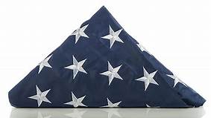
Fold3
https://library.princeton.edu/resource/title/fold3
Pension applications
Draft records (WWI and WWII)

Slide 12
Ancestry
https://library.princeton.edu/resource/4319
Draft records (Civil War, WWI and WWII)
Burial locations for those killed in action
Pension records

Slide 13
National Park Service Soldiers and Sailors Database
https://www.nps.gov/civilwar/soldiers-and-sailors-database.htm
Service records for the Civil War

Slide 14
City Directories
Lists name, address, and profession; sometimes employer as well
Can provide context or fill in gaps between Censuses (or for more recent periods when Census isn’t available)
No one source, but do a catalog search on Subject=[name of city]—Directories
Ancestry has many city directories; others are available through HathiTrust and Google Books

Slide 15
Using Ancestry.com for U.S. Immigration records

Slide 16
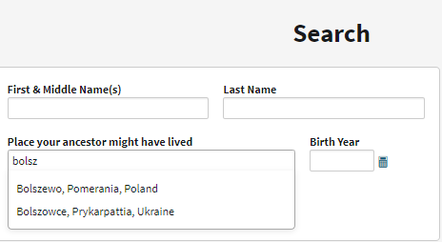
I prefer the Place Search in Ancestry and its link into the catalog of available resources.
I recommend using our access to Ancestry and then supplementing with FamilySearch as needed.

Slide 17
Principles of searching are similar to library work
People’s names change – both first and last
So do place names and borders
People may misrepresent their location
Ex: report being from a larger town or perhaps where they were born.
Jewish people noted as “Hebrew” in census.
Pay attention to history and geography.
Like exit rows, the closest port may be behind you (e.g., in another country)
Iterative process
People may not have come over together
Or may have come over, returned, and come back again.
Naturalization applications may be more helpful because they probably have a correct date of entry.
Disambiguating names is a big challenge
https://rbsc.princeton.edu/collections/hermann-broch-collection

Slide 18
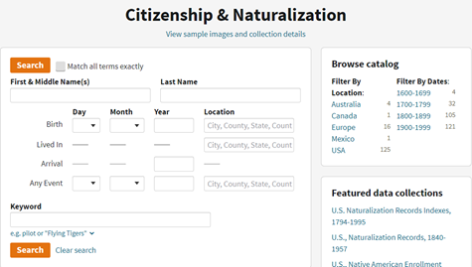
Subcategories of immigration
I like to search each of the major categories separately
Easier to work with shorter results lists.
Unlike census, people who weren’t here during census years may have immigration records.
Unlike other countries, US doesn’t record emigration.

Slide 19
Passenger Lists
United States records going back to 1820
Listed port of departure is not always the original port of departure
Often the port prior to arriving at the port of New York.
Ex: if your ancestors emigrated to the U.S. from Germany, they could be found on a passenger list coming from Liverpool, England. (https://search.ancestrylibrary.com/search/db.aspx?dbid=7488). But you should also see who they landed with in Liverpool with and also look for Hamburg lists.
Hamburg was a major port of departure for Central and Eastern Europ
Nearly 33% of Germans and 90% of Eastern European emigrants (Russia, Poland, Austria-Hungary, Romania)
https://www.familysearch.org/wiki/en/Hamburg_Passenger_Lists
Search by name and birth year for starters

Slide 20
Citizenship & Naturalization Records
Perhaps more accurate than passenger lists
may include info on parents even if they didn’t come with them
Not all immigrants stayed and of those who did, not all applied for citizenship
Rules changed over time, especially for women¹
People had to declare intent and then wait a period of years before applying for naturalization²
Sometimes referred to as “taking out first papers.”
U.S. Citizenship and Immigration Services records³ include immigrants who:
naturalized between September 27, 1906 and March 31, 1956;
arrived as immigrants from July 1, 1924 to May 1, 1951;
registered as aliens (non-citizens) under the 1940 Alien Registration Act between August 1940 and March 31, 1944
arrived before 1924 and later underwent Registry (legalization) between 1929-1944.
https://search.ancestrylibrary.com/search/group/us_naturalization#databases

Slide 23
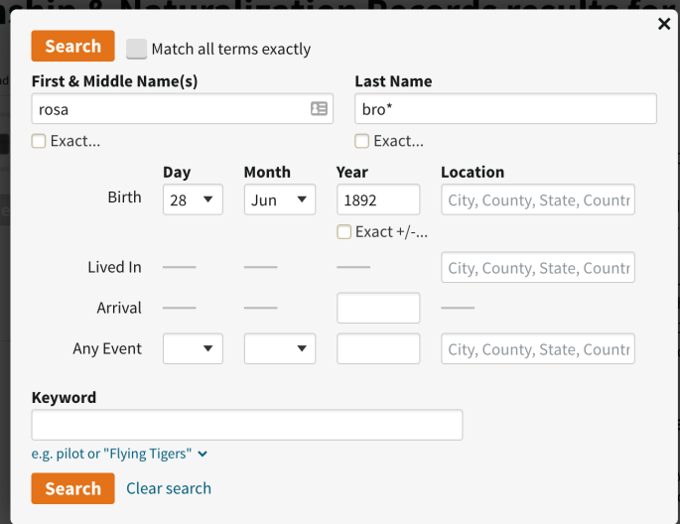
https://search.ancestrylibrary.com/search/db.aspx?dbid=6927
In 2010, the USCIS began transferring records of immigrants who were born more than 100 years ago to the National Archives for retention.
Ordering Your Ancestor’s A-File
original case files are located at the National Archives at Kansas City
make sure to include the Alien Registration Number and the individual's complete name when requesting a copy of a file. The National Archives will accept requests by e-mail, postal mail, or fax.
E-mail: Afiles.KansasCity@nara.gov

Slide 24
Name | Rose Browka
Event Type | Immigration
Birth Date | 28 Jun 1892
Affiliate Record Identifier | 3388600
Rose Browka
United States Index to Alien Case Files
Dear Ms. Broch:
Thank you for your inquiry, dated May 23, 2016, regarding the A-File of Rose Browka.
Here are some details from the file you referenced which may aid in confirming a match to the individual you are seeking:
Rose Browka, A3388600
Entered the United States under the name of Rose Kuklis.
Born on June 28, 1892 in Wilno, Poland, Russia.
Married.
Children: 4
First entered the United States on May 5, 1913 at New York City, NY.
Place of residence: Verona, NY
This file consists of 4 pages. If you would like to order a copy of these records, the National Archives charges a $20.00 minimum fee covering the first 25 pages of an order. The total charge for this order is $20.00…

Slide 25
Border crossings— steamships and railroads

Slide 26
Crossing at St. Albans
Notes:
https://www.ancestrylibrary.com/interactive/60579/41260_322104-01715?pid=3126639&backurl=https://search.ancestrylibrary.com/cgi-bin/sse.dll?_phsrc%3DJAm428%26_phstart%3DsuccessSource%26usePUBJs%3Dtrue%26qh%3DXMtOIIbELYwKS5vgMhNRHA%253D%253D%26gss%3Dangs-c%26new%3D1%26rank%3D1%26gsln%3Dkashket%26gsln_x%3D0%26msady%3D1921%26msady_x%3D1%26MSAV%3D1%26uidh%3Dfo7%26pcat%3D40%26h%3D3126639%26dbid%3D60579%26indiv%3D1%26ml_rpos%3D2&treeid=&personid=&hintid=&usePUB=true&_phsrc=JAm428&_phstart=successSource&usePUBJs=true

Slide 27
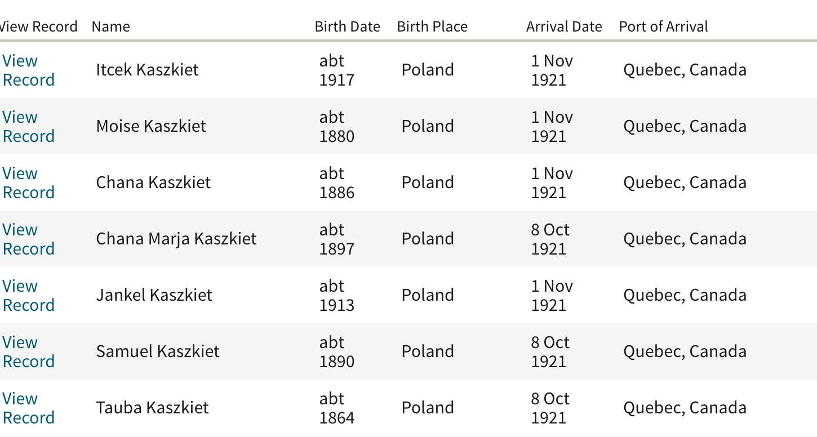
Note two Chana Kaszkiets 5 weeks apart

Slide 28
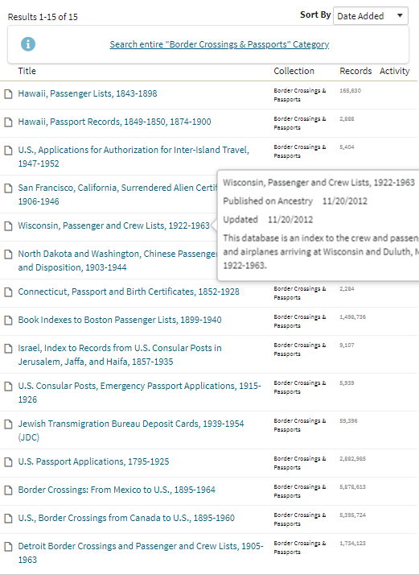

Slide 29
Concluding remarks
Language translation and handwriting deciphering
https://www.jewishgen.org/viewmate/
Google translate
Facebook Genealogy groups
Other genealogy groups
Persistence is key
top few hits on the list may not be your person, but you have to keep going.
Would be nice if you could sort the columns but you have to do work arounds of that.
I haven’t touched on privacy rules, which impact what is available.

Slide 30
Notes
https://www.ancestrycdn.com/institution/Pdf/researchAids/10-things-to-know-about-passenger-lists-fe29cbe2.pdf
https://www.archives.gov/publications/prologue/1998/summer/women-and-naturalization-1.html
https://www.uscis.gov/history-and-genealogy/our-history/historians-mailbox/history-declaration-intention-1795-1956#VI
https://www.uscis.gov/history-and-genealogy/genealogy/historical-records-series-available-genealogy-program

